Slide 1
IO Lab
Spring 2016
Module 2 - Lec 3 - Javascript
Feb 5, 2016

Slide 2




Course Map
Getting Started
Front End
Back End
Advanced Topics
Introduction
Fundamentals
Git
Command Line
HTML
CSS
Responsive Design
JavaScript & jQuery
Web Frameworks
Architecture
Database Design
APIs
Visualization
Security
Deployment

Slide 3
Course Map
Getting Started
Front End
Back End
Advanced Topics
Fundamentals
Git
Command Line
HTML
CSS
Responsive Design
JavaScript & jQuery
Web Frameworks
Architecture
Database Design
APIs
Visualization
Security
Deployment

Slide 4
Front End Module
HTML
CSS & Responsive Design
JavaScript & jQuery

Slide 5
Front End Module - JavaScript
HTML
CSS & Responsive Design
JavaScript & jQuery

Slide 6
Goals for Today
JavaScript basics
Getting your hands dirty
Walking through some examples together

Slide 7
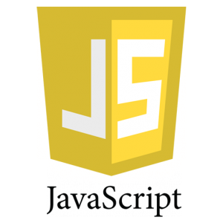
JavaScript - The Modern Web Controller
Web page interaction
Manipulate HTML & CSS via the DOM
Web frameworks
Dynamic web content
Vast support

Slide 8
Scripting Basics
Scripts are a set of commands that an interpreter executes (no need for compilation)
They are read line-by-line by an interpreter, which translates those commands into machine code
Your Web browser has a JavaScript interpreter
You can load JavaScript files or run JavaScript in your HTML file
You can also code on-the-fly in the browser’s console
Brush up on compiled vs. interpreted langauges

Slide 9


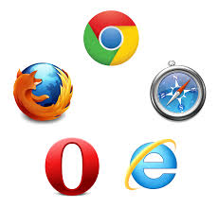
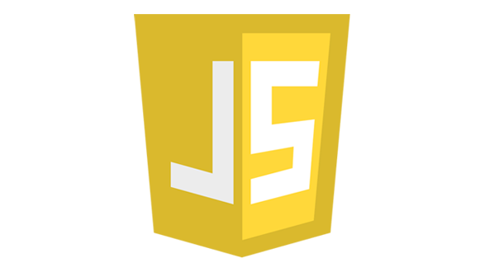

JavaScripting Visualized
Browser updates DOM and renders changes
User interacts with web page
Link to JS file in HTML
Browser interprets JS script
Possibly request data from external resources
Part of the JavaScript is executed

Slide 10
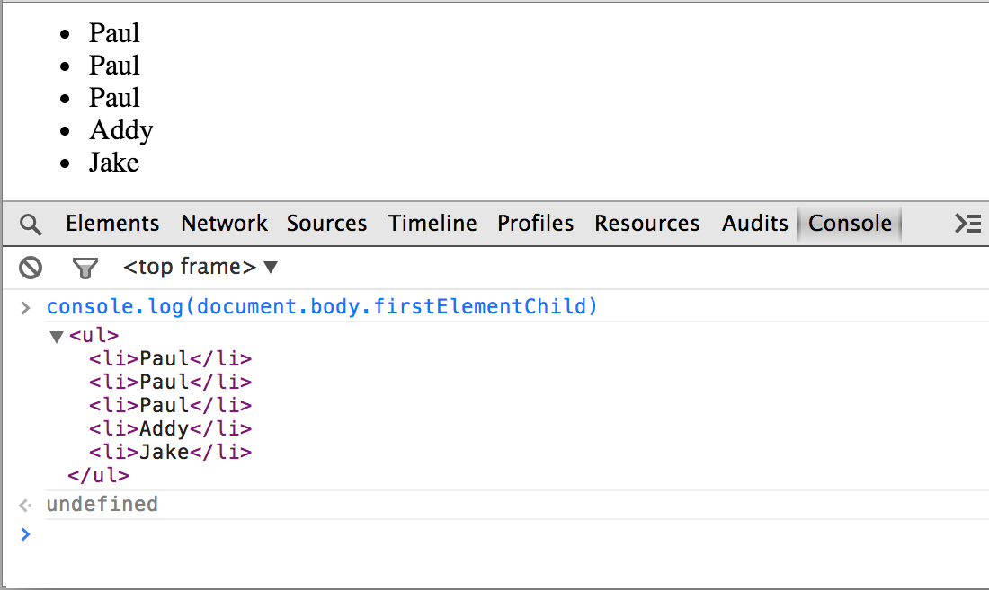
Browser Console
It’s your browser’s JavaScript interactive terminal
You can enter code line-by-line to be interpreted on-the-fly
Useful for testing & debugging

Slide 11
console.log() & alert()
Use console.log() to output to the browser console
Similar to the print statement in Python - useful for testing
Use alert() to pop up an alert to the user - also useful for testing

Slide 12
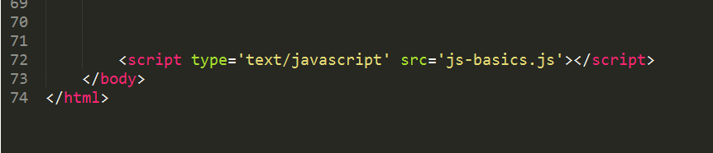
Loading JS Files
Load JavaScript files with a <script> tag in your HTML
Put these at the end of the body so your content has a chance to load first before you manipulate it

Slide 13
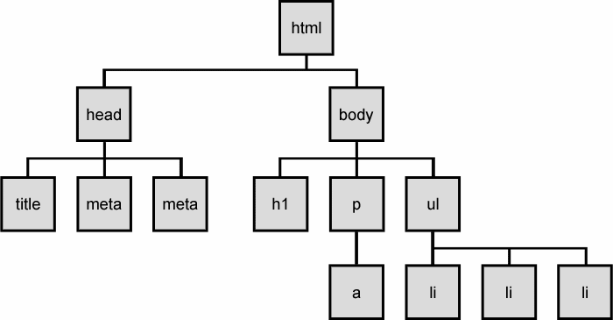
Our Good Friend, The DOM
Document
Object
Model
Your browser converts HTML into the DOM for rendering and manipulation - we’re going to manipulate it with JavaScript

Slide 14
Traversing the DOM
Parents & Children
Select element(s) using
getElementById()
getElementsByClassName()
getElementsByTagName()
childNodes()

Slide 15
window.onload()
Fire events when page is fully loaded, including all external resources
There is also document.onload, which fires when DOM is loaded (generally very quickly), but is not widely supported

Slide 16
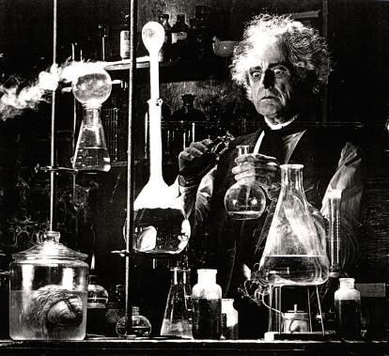
Manipulating the DOM
Accessing & setting HTML with .innerHTML
Accessing & setting attributes
.getAttribute(“attributeName”)
.setAttribute(“attributeName”, “attributeValue”)
Can also access & set style with .style.attribute

Slide 17

Manipulating the DOM cont’d.
parent.appendChild(child)
parent.insertBefore(new, current)
parent.removeChild(child)

Slide 18

Variables & Hoisting
Use ‘var’ to declare variables
Unless you’re accessing variables within scope
All variables are ‘lifted’ and declared (but not assigned) at top of function (or top of script if outside of a function)

Slide 19
Function Declarations
Generally take the form:
function someFnName(param1, param2,... paramN) { //execute some code here}
Can be called anywhere within script, even before declaration
This is because function declarations are hoisted like variables

Slide 20
Function Expressions
Generally take the form:
var x = function(param1, param2,... paramN) {//execute some code here};
Can be anonymous (without a name)
Good for use within conditionals, loops, and simple event handlers
Function expression variable names are hoisted, but definition is not
Ex: var x = function() {};
x as a variable name is hoisted
the definition of x is not hoisted
A good explanation of Function Declarations vs. Function Expressions (Operators)

Slide 21
Scope
Scope is the context in which a variable exists and can be accessed
JavaScript has function-level scope, not block-level (blocks = curly braces)
Variables declared inside a function using ‘var’ are local
Only that function and child functions can access
Function arguments are local
Variables declared outside a function are global
So are variables invoked inside a function without ‘var’
Try not to clutter the global scope with unnecessary variables
A good explanation of scope

Slide 22
Conditionals
If, else if, and else
Take the general form:
if (//some conditional logic) { //execute some code }
else if (//more conditional logic) { //execute more code }
else (//more conditional logic) { //execute more code }

Slide 23
Logical Operators
AND denoted by &&
OR denoted by ||
NOT denoted by !
Equality denoted by === for strict equality (must match type); == for loose equality
Not Equals denoted by !=
Read more about === vs ==

Slide 24
JavaScript - For Loops
Take the general form:
for (var i=0; i < x; i++) { // do some stuff }
Declare ‘counter’ variable i
Condition under which to continue loop
Increment the counter by 1

Slide 25
JavaScript - Arrays
Take the general form: var array = [elem1, elem2,... elemN];
Access elements by index
The .slice() method
Closing index is exclusive
Ex: array.slice(0, 3) returns a new array with the 0th through 2nd elements of the original array
.slice() also works with strings
The .push() method
Adds elements to end of an array

Slide 26
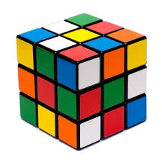
JavaScript - Objects
Take the general form:
var obj = { name: value,
name2: value2,
etc… }
Values can be anonymous functions
Call as if a method: obj.name()
Access and set values with dot notation
Ex: obj.name = ‘Rubik’;
Dig deeper into JS objects

Slide 27

JavaScript - setTimeout() & setInterval()
setTimeout() is like a one-shot function call after a countdown (in milliseconds)
always operates in the global scope
Ex: setTimeout(blastOff, 5000);
setInterval() is like a repeated function every x milliseconds
Ex: setInterval(incrementSecond, 1000);

Slide 28
JavaScript - Semicolons
Most common examples of semicolon necessity are after
variable declaration var x;
value assignments x = 2;
return statements return x;
function invocation findValue();
A guide to semicolon usage Another good explanation of semicolon usage

Slide 29
JavaScript - In-Class Exercise
We’re going to go through examples of the concepts we learned today
Download the files from bCourses or pull from the IO Lab Git repo
Your next challenge is to create three JS ‘cat’ objects and insert them into the DOM
Use the instructions near the bottom of the JS file

